Slide 1

Retail Price Optimization
Using Supervised Learning
Contributors
Greer Inns
Sarah Kim
Nolan Tonthat
Sam Spillane
Nazeli Mnatsakanyan
Jing Sy

Slide 2
Introduction
Problem
Setting the right price for products is essential to maximize profits and meet business goals
However, determining the optimal price for each product can be a very complex and time-consuming task
The challenge that many businesses face is being able to efficiently leverage the data to make informed pricing decisions that finds the balance between profitability and market demand
Solution
Utilizing a linear regression model to analyze products, categories, competitive pricing, and customer ratings from the acquired data to accurately recommend optimal prices for various products
Enabling retailers to make strategic business decisions
Data Sources:
https://www.kaggle.com/datasets/suddharshan/retail-price-optimization?resource=download

Slide 3
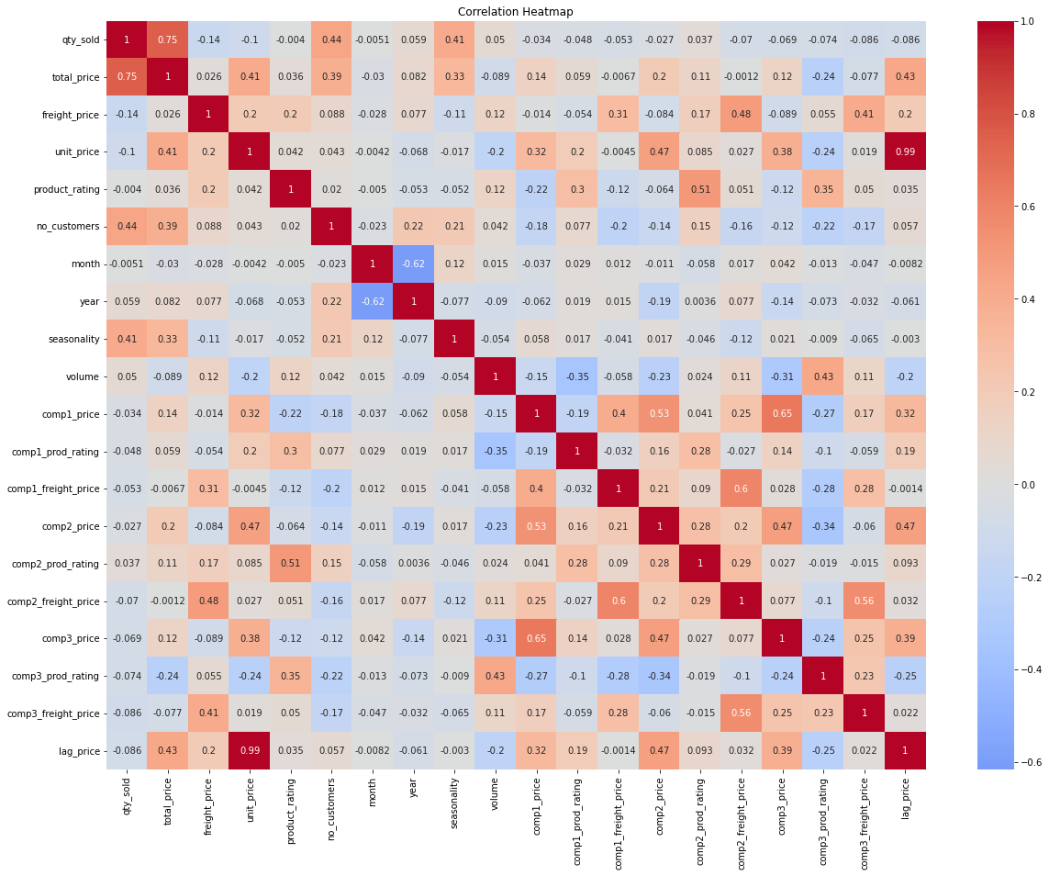
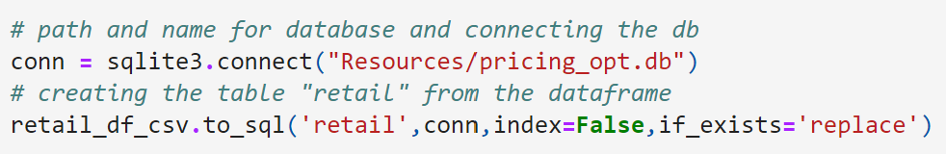
ETL/EDA
Correlation Heatmap
Largest Correlations
Unit Price vs. Lag Price
Qty Sold vs. Total Price
Comp 1 Price vs. Comp 3 Price
Comp 1 Freight Price vs. Comp 2 Freight Price
Other EDA visualizations (Dashboard):
Box Plot of Product Category vs. Unit Price
Scatter Plot of Qty Sold vs. Unit Price

Slide 4
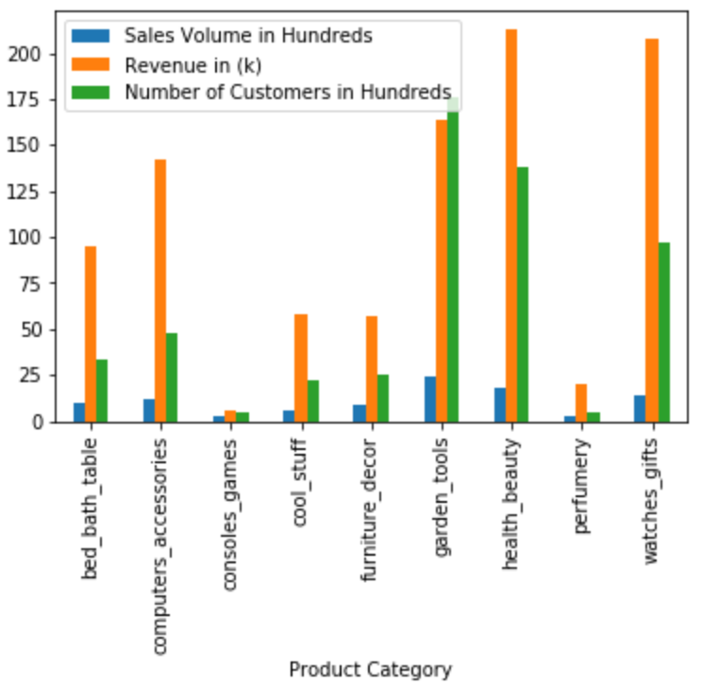
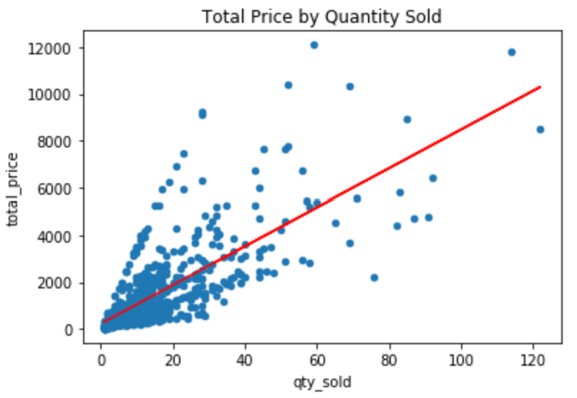
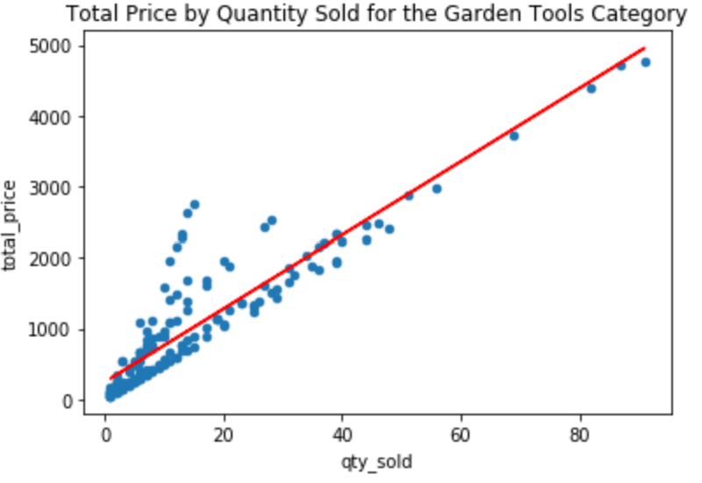
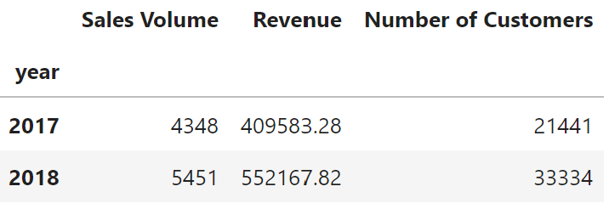
EDA
Other Observations:

Slide 5
Build, Test, Train, Evaluate
Models Used:
Cumulative Training with Linear Regression (LR)
Sliding Window with LR
Sliding Window with Random Forest (RF)
Sliding Window with Extreme Gradient Boosting (XGB)

Slide 6
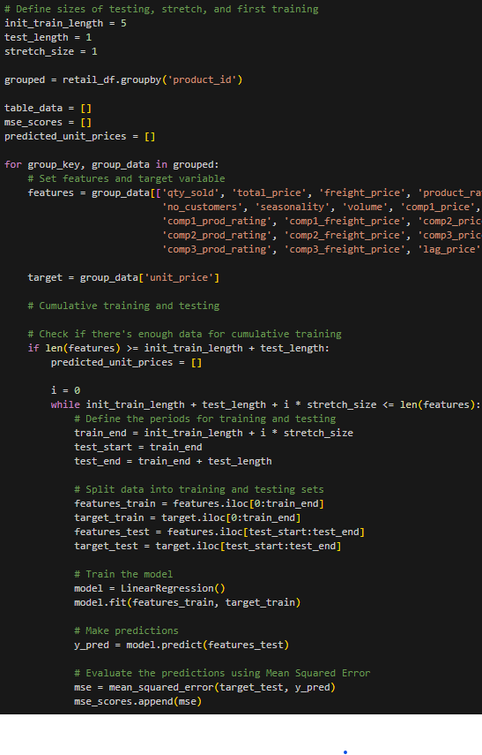
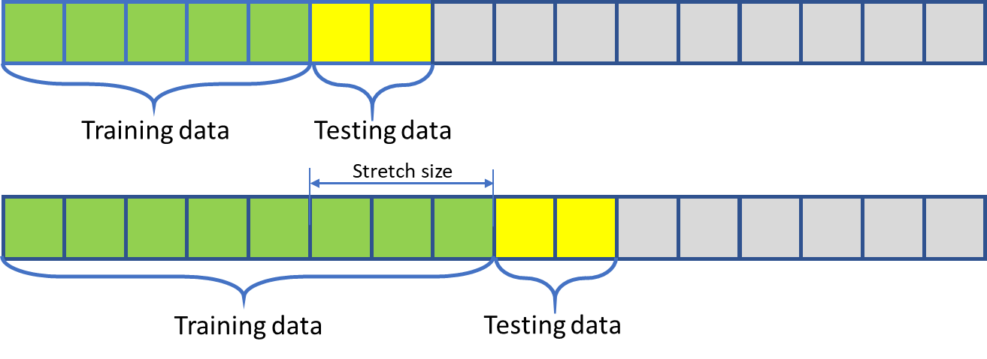
Cumulative Training with Linear Regression
Step 1: Define sizes of testing, stretch, and first training
Step 2: Group by product and set features/target variable
Step 3: Cumulative training and testing to predict data points
Step 4: Linear Regression Model Training using training data (features_train, target_train)
Step 5: Unit price predictions (features_test)
Step 6: Evaluate using Mean Squared Error (MSE) - actual vs. predicted
Step 7: Calculate avg MSE and loop to find price with min MSE
→ Optimal Price

Slide 7
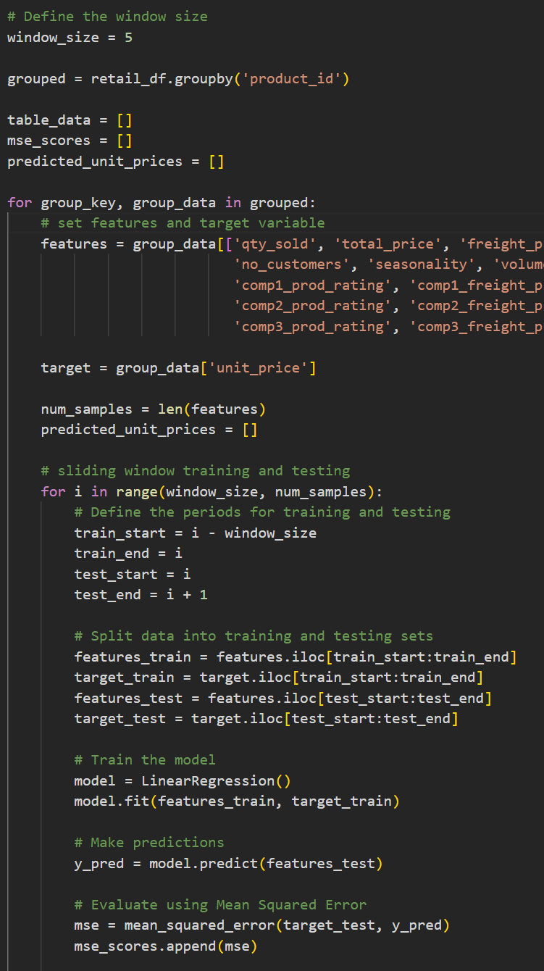
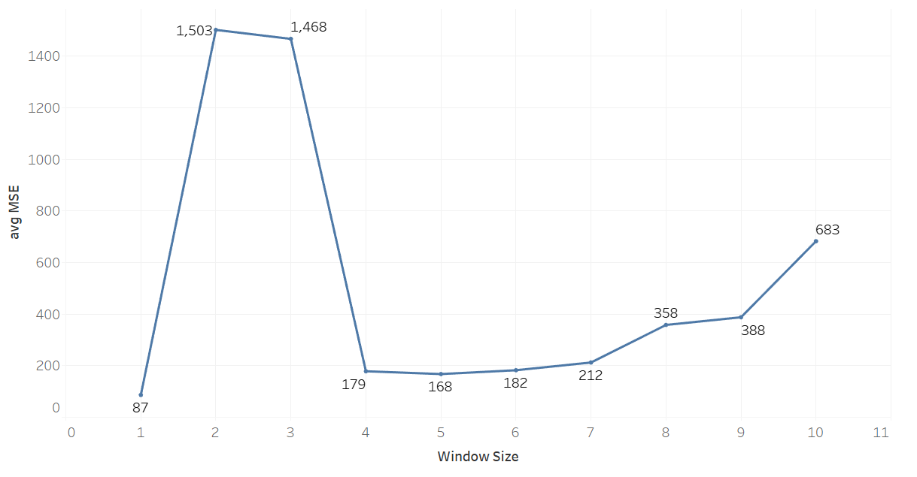
Sliding Window with Linear Regression
Step 1: Define Window Size (5)
Step 2: Group by product and set features/target variable
Step 3: Sliding Window training and testing to predict data points
Step 4: Linear Regression Model Training using training data (features_train, target_train)
Step 5: Unit price predictions (features_test)
Step 6: Evaluate using Mean Squared Error (MSE) - actual vs. predicted
Step 7: Calculate avg predicted price and MSE and loop to find price with min MSE
→ Optimal Price

Slide 8
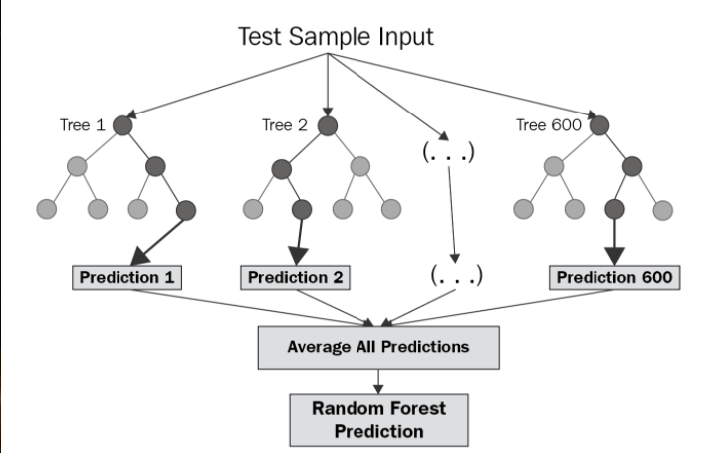
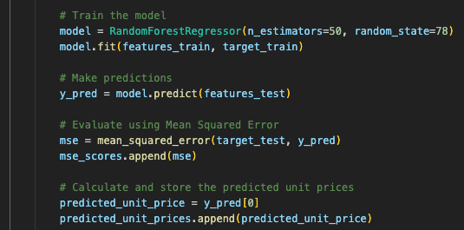
Sliding Window with Random Forest
Step 1: Define Window Size (5)
Step 2: Group by product and set features/target variable(s)
Step 3: Sliding Window training and testing to predict data points
Step 4: Random Forest Regressor Model Training using training data (features_train, target_train)
Step 5: Unit price predictions (features_test)
Step 6: Evaluate using Mean Squared Error (MSE) - actual vs. predicted
Step 7: Calculate avg predicted price and MSE and loop to find price with min MSE
→ Optimal Model for Predicting Price

Slide 9
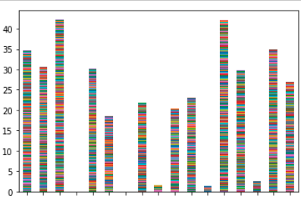
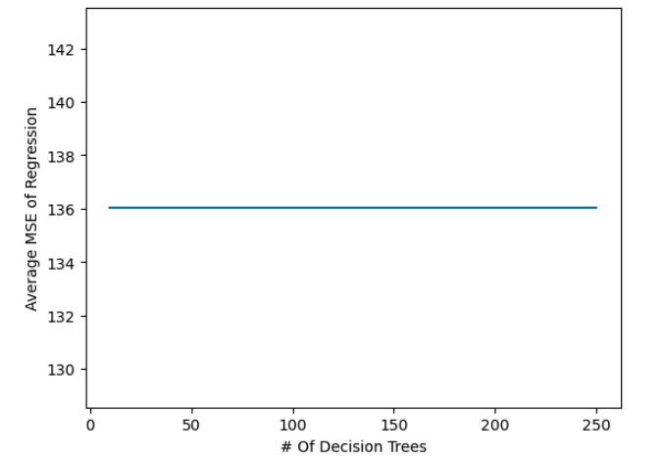
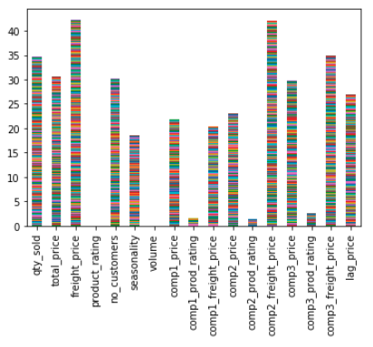
Sliding Window with Random Forest Cont’d
Feature Importance:
Decision Tree Optimization:
Standard Scaling
Original

Slide 10
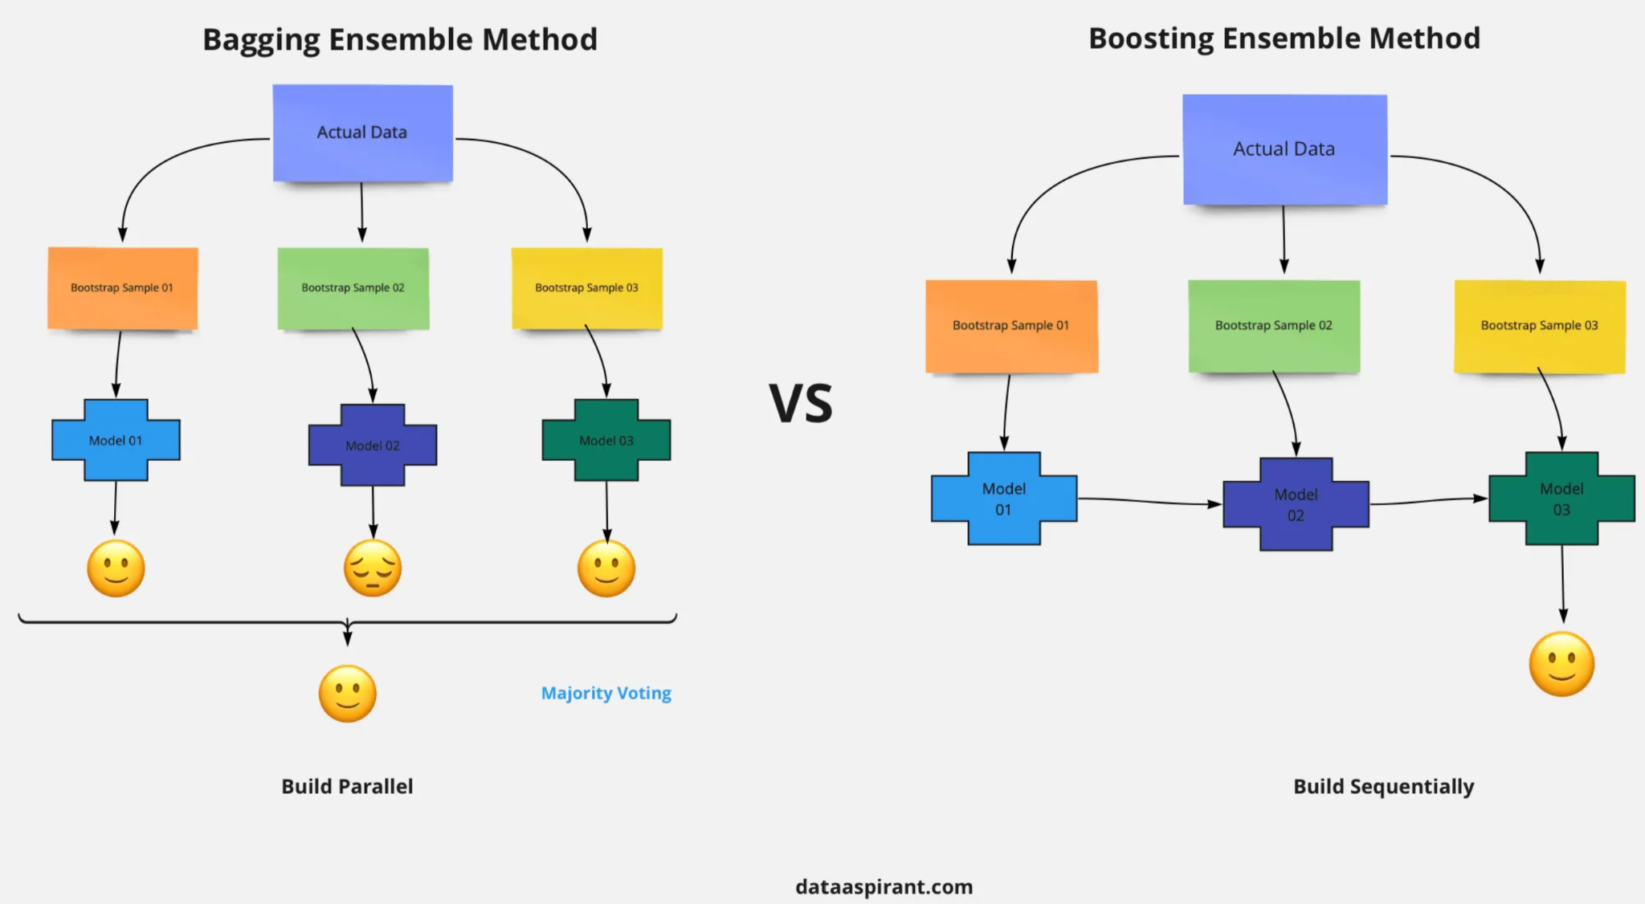

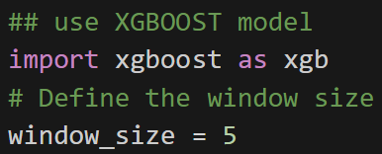
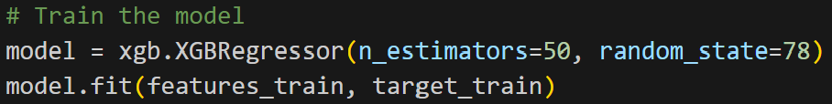
Sliding Window with XGBoost
Notes:
Gradient boosting is to minimize the loss function of the model by adding weak learners using gradient descent. Gradient descent is a first-order iterative optimization algorithm for finding a local minimum of a differentiable function. Different types of loss functions can be used.
Random Forest is a bagging technique that contains a number of decision trees on various subsets of the given dataset, and is based on the majority votes of predictions.
On the other hand, boosting method is iterative learning, meaning that the model will predict something initially and self analyses its mistakes and give more weightage to the data points in which it made a wrong prediction in the next iteration. This process continues as a cycle. XGBoost is a good option for unbalanced datasets whereas Random Forest is lacking in this perspective.

Slide 11
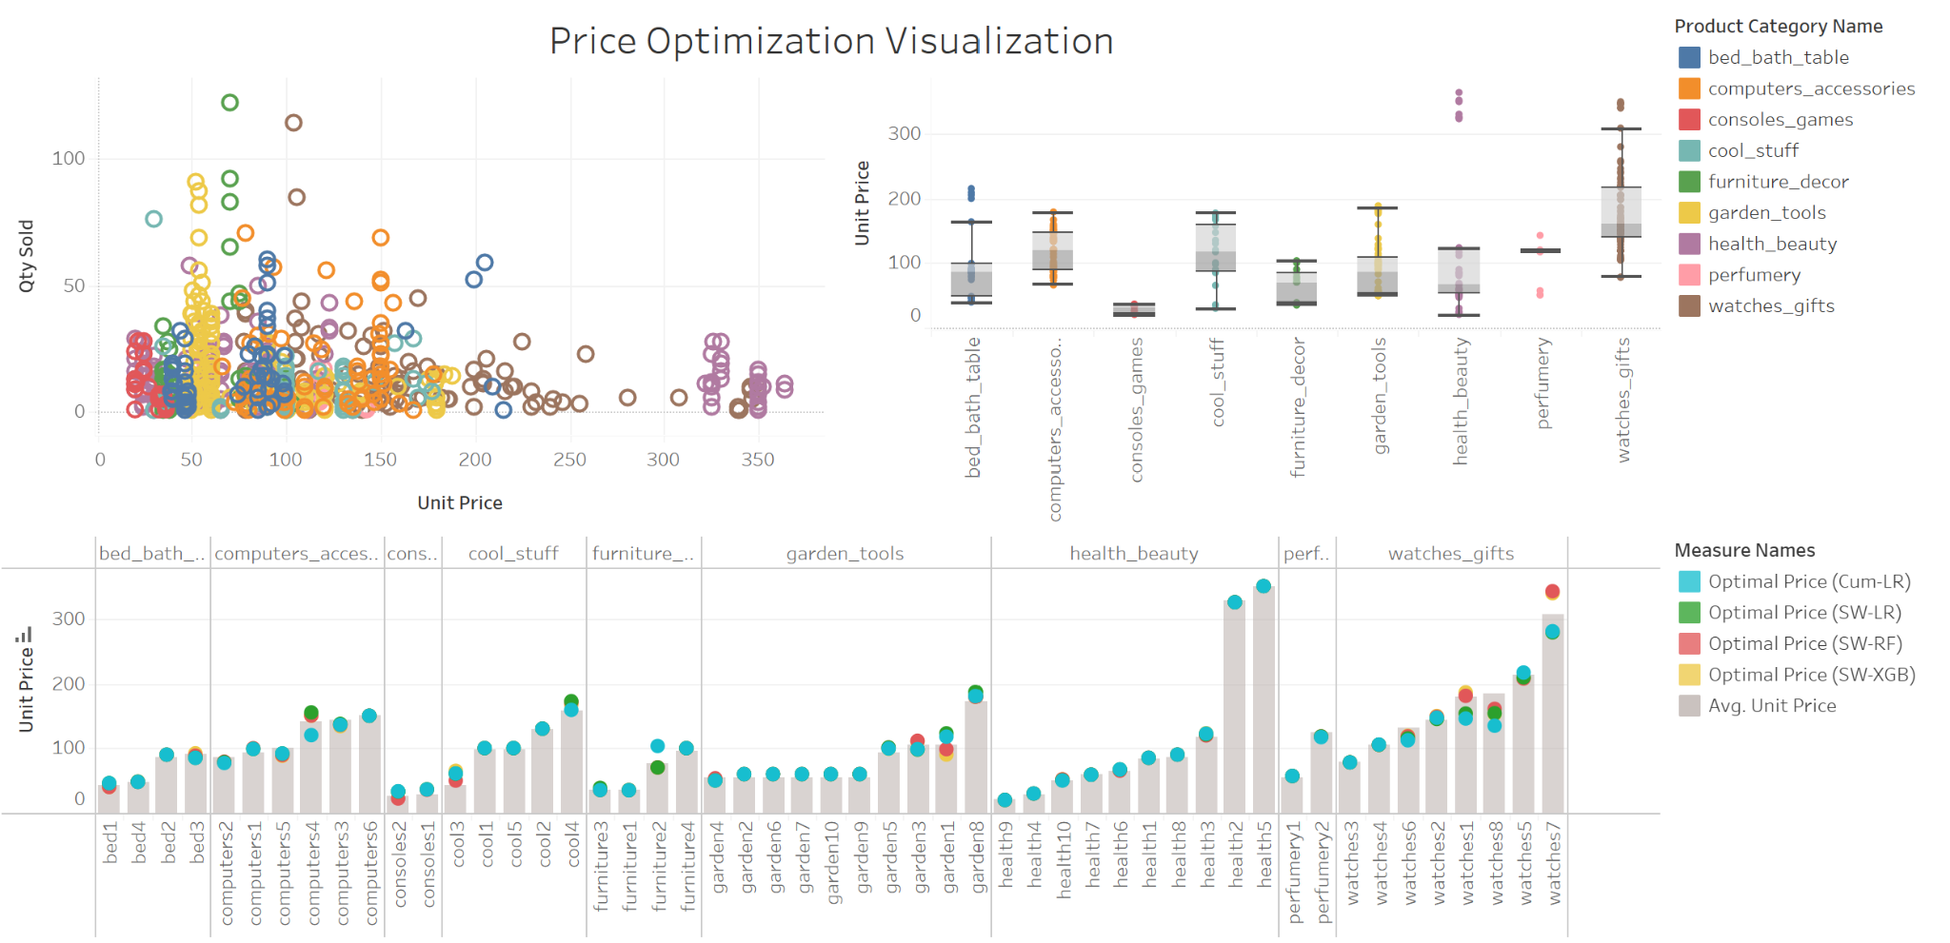
Dashboard!
Price_Optimization_Final | Tableau Public

Slide 12
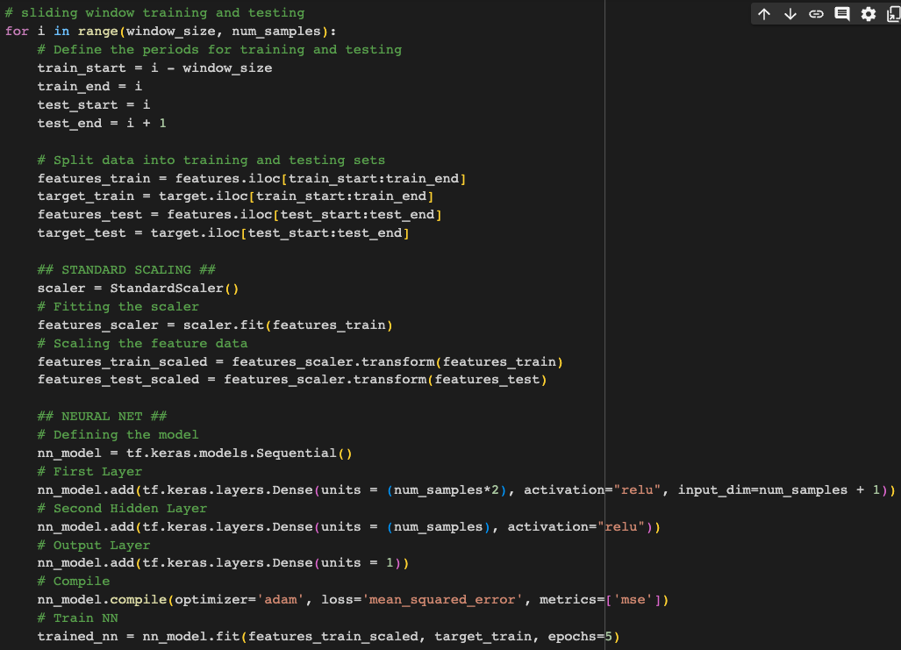
Challenges
Failed Models
Neural Network
Linear Regression (Lasso)

Slide 13
Future Steps
Optimize existing models (e.g. Random Forest, XGBoost) by adjusting the number of estimators to avoid data underfitting or overfitting
Test outside datasets to our trained models
Correct and optimize Neural Network model

Slide 14

Thank you!

